Slide 1
Finite Automate

Slide 2
Finite Automata FA
Simplest Model of Computation (Small Computer/Controller)
It started as a simple automatic device with no memory. We still need it to study how to model a device and model its capability.
Its goal is to act as a recognizer for specific a language/pattern.
Any problem can be presented in form of a decidable problem that can be answered by Yes/No.
A problem can be concatenated to one of its possible solutions as a string that matches a pattern.
Hence FA can solve finite and small problems.

Slide 3
What does an FA do?
Read an input string from tape
Determine if the input string is in a language
Determine if the answer for the problem is “YES” or “NO” for the given input on the tape

Slide 4
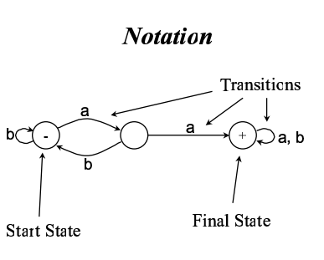
Notations used in FA

Slide 5
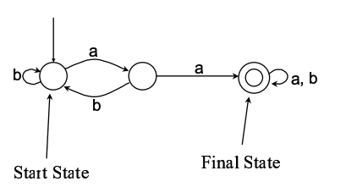
Alternative notations

Slide 6
Deterministic Finite Automata DFA
FA = “a 5-tuple “ ➔(Q, Σ, δ, q₀, F)
Q: {q₀, q₁, q₂, …} is set of states(Nodes).
Σ: {a, b, …} set of alphabet.
δ(delta): represents the set of transitions(Edges) that FA can take between its states.
δ : Q x Σ→Q
Q x Σ to Q, this function:
Takes a state and input symbol as arguments.
Returns a single state.
q₀ Q is the start/initial state(Exactly One).
F Q is the set of final/accepting state(s).

Slide 7
Transition function δ
δ : Q x Σ→Q
Maps from domain of (state, letter) to range of states.
Q
Q x Σ
(q₀, a)
q₁
(q₀, b)
(q₂, b)
q₂
(q₁, b)
q₃

Slide 8
Finite Automata
Can Generate Strings
Start at starting state
Take transitions at random
Finish up only in an accepting state
Can Recognize Strings
Start at starting state
Follow transitions as determined by the symbol in the string
Process al symbol in a string
Do you end at accepting state or not?
If a machine does not accept any string then it accept empty string

Slide 9
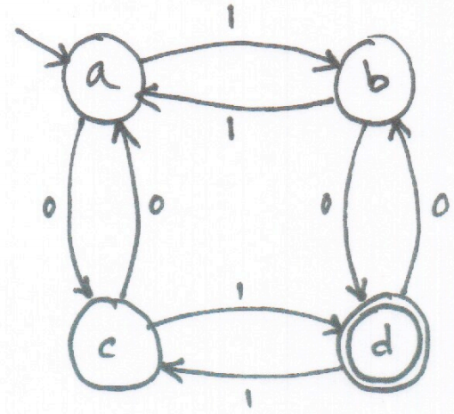
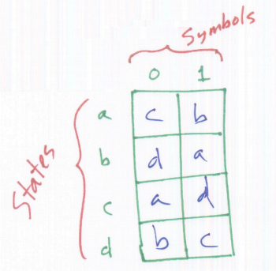
Finite Automata
FA -“a 5-tuple “ (Q, Σ, δ, q₀, F)
Q: {a, b, c, d} is set of states(Nodes).
Σ: {0, 1} set of alphabet.
q₀=a
F={d}
δ(delta):
Notes:
Plausible

Slide 10
How does FA work?
Starts from a start/initial state.
Loop
Reads a letters from the input
Until input string finishes
If the current state is a final state then
Input string is accepted.
Else
Input string is NOT accepted.
But how can FA be designed and represented?
Notes:
Its tape head points at the first cell
move its tape head to the right one cell

Slide 11
When does an FA stop working?
When it reads all symbols on the tape
Then, it gives an answer if the input is in the specific language:
Answer “YES” if its last state is a final state
Answer “NO” if its last state is not a final state

Slide 12
Finite Automata - A Short Example
The control of a washing machine is a very simple example of a finite automaton.
The most simple washing machine accepts quarters (1/4 of a US $) and operation does not start until at least 3 quarters were inserted.
The second washing machine accepts 50 cents coins as well.
The most complex washing machine accepts $1 coins too.

Slide 13
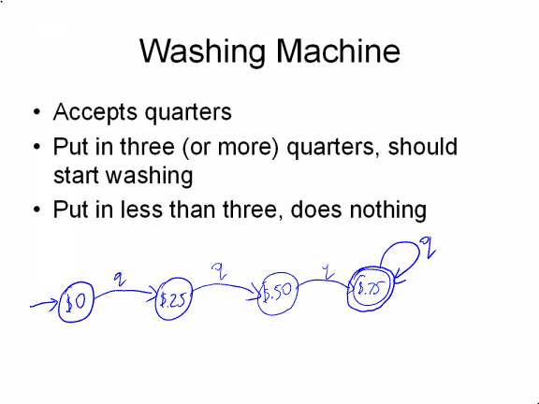

Slide 14
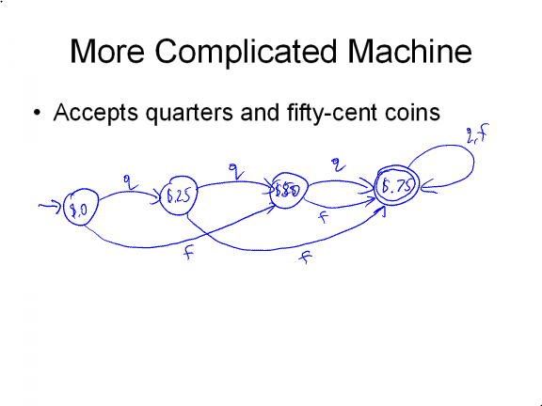

Slide 15
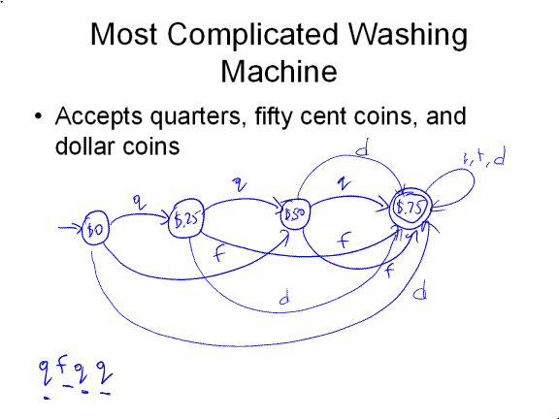

Slide 16
How an FA works
0
1
0
s
f
1
Input: 001101
0
0
1
1
0
1
ACCEPT
Input: 01001
0
1
0
0
1
REJECT

Slide 17
Representation of FA: Graph
States= nodes
Starting state denoted by –
Final state(s) denoted by +
Transition function δ =directed arrows connecting states.
Build an FA for RE “a*b(a+b)*”
a
a,b
-
+
S₁
S₂
b

Slide 18
Representation of FA: Table
“-” sign for
start state
input symbols
a
b
-s₁ s₁ s₂
+s₂ s₂ s₂
Final states
Indicated by “+”
Rows = states

Slide 19
Example: Constructing FA
Build an FA that accepts only aab
S₁
S₂
S₃
S₄
-
a
a
b
+
 | a | b
S₁ | S₂ | S₅
S₂ | S₃ | S₅
S₃ | S₅ | S₄
S₄ | S₅ | S₅
a
b
a,b
b
S₅
a,b

Slide 20
Example: Constructing FA
Build an FA that accepts only aab
S₁
S₂
S₃
S₄
-
a
a
b
+
 | a | b
S₁ | S₂ | ?
S₂ | S₃ | ?
S₃ | ? | S4
S₄ | ? | ?

Slide 21
FA accepting nothing
FA with no final states
b
-
a
a,b
FA with disconnected graph. Start state does not have a path to the final state.
b
+
-
a
b
a,b

Slide 22
Example: Constructing FA
(a+b)*
±
a, b

Slide 23
Example: Constructing FA
All words with even count of letters.
((a+b)(a+b))*
a, b
1±
2
a, b

Slide 24
Example: Constructing FA
All words that start with “a”
a(a+b)*
b
a,b
2
2
b
1-
1-
3 +
a
3 +
a
a,b
a,b
Does not accept all inputs

Slide 25
Example: Constructing FA
All words that start with “a”
a(a+b)*
a,b
b
2
1-
a,b
a
3 +
Special accept state for string “a”, might give better performance in hardware implementation

Slide 26
Example: Constructing FA
All words that start with triple letter
(aaa+bbb)(a+b)*
a
a
a
2
3
1-
6+
a,b
4
5
b
b
b

Slide 27
Example: Constructing FA
+
a
a,b
a,b
-
a,b
b
5
{aa, ba, baba, aaaa, bbba, abba, aaabaa, …}
All words with even count of letters and ends with “a”. ➔(a+b)a ((a+b)a ((a+b)b(a+b)a)* )*

Slide 28
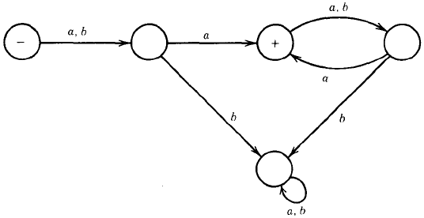
Example: Constructing FA
a,b
-
{aa, ba, baba, aaaa, ab, bb, bababa, aaba, …}
All words with even count of letters having “a” in an even position from the start, where the first letter is letter number one. ➔(a+b)a((a+b)a)*

Slide 29
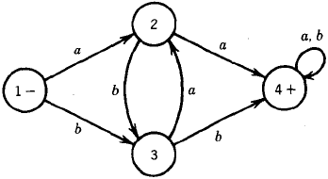
Example: Constructing FA
Consider the following FA:
Whenever aa exists, the first “a” must take us to state 2.
Either way, the next a takes us to state 4. Similar situation with “bb”.
In summary: this FA accepts strings that have a double letter in them.
(a + b)*(aa + bb)(a + b)*

Slide 30
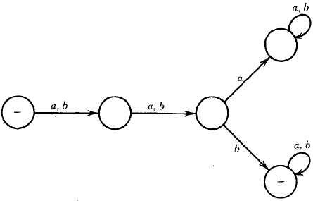
Example: Constructing FA
Consider the following FA:
Accepts all words with b as the third letter and reject all other words.
A word that has fewer than three letters fails.
RE1: (aab + abb + bab + bbb)(a + b)*
OR :(a + b)(a + b)(b)(a + b)* = (a + b)² b (a + b)*
Notice that this last formula is not strictly speaking a regular expression, since it uses the symbol “2”

Slide 31
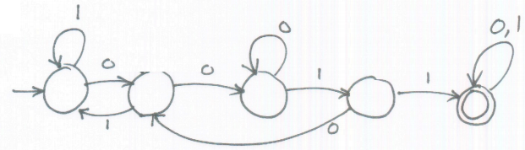
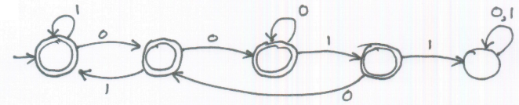
Another Design Example
Σ: {0, 1}, we want to design any string that does not contain “0011” in it
First built a machine that accepts “0011”
M1
Then change the start/final states to get required machine
M2

Slide 32
Language generated from machine
L(M1): The language that M1 recognizes
The set of strings over Σ: {0, 1}* that contain 0011 as sub string
L(M2): The language that M2 recognizes
The set of strings over Σ: {0, 1}* that does not contain 0011 as sub string
The universe : All possible strings made with symbols from the alphabet Σ: {0, 1}
Universe= {0, 1}*

Slide 33
Regular Language
A language is regular iff some finite state machine recognizes it
What languages are not regular?
Anything that requires memory (F.S.M has limited memory)
F.S.M Cannot store the string
F.S.M cannot count characters of string

Slide 34
Have you see any memory? Ex10
All strings that end in ab.
Do we need a memory to remember the last two letters?
a
a
a
b
b
a
b
…
…
-
b
+
a
…
b
b
…
b
b

Slide 35
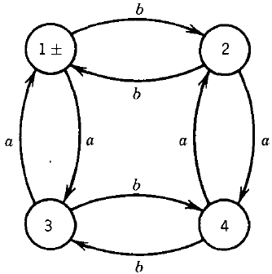
Example: Constructing FA
Even-Even :
All the words that end in state 3 have an even number of b's but an odd number of a's.
All words that end in state 4 have an odd number of a's and an odd number of b's.
Any EVEN-EVEN words
must end in state 1 and be accepted.

Slide 36
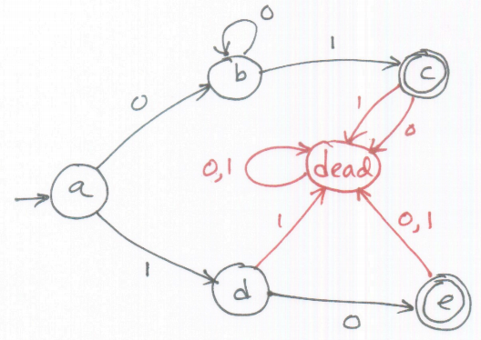
Dead States
If some transitions are missing then add dead state(Often prefer not to show a dead state)

Slide 37

Complement
If L is a language, then its complement is
L’ = {w | w ∉ L}
Let A = {w | w is a string of 0s and 1s containing an odd number of 1s}. What is A' ?
Let B = {w | w is a string of over {a,b} that starts and ends with the same symbol}. What is B' ?

Slide 38
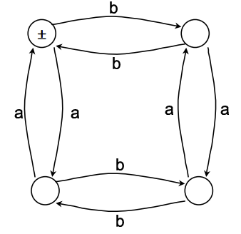
FA of EVEN EVEN

Slide 39
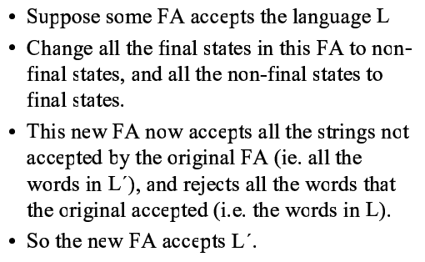
Complement FA

Slide 40
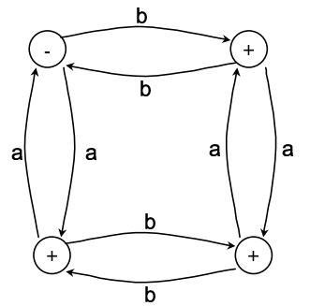
FA of EVEN EVEN Complement

Slide 41
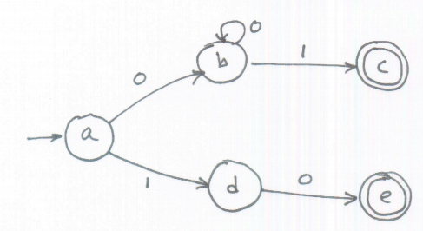
Another Example
What does following F.S.M recognizes?
L={w|w is either 10 or a string of at least one 0 followed by signle 1}

Slide 42
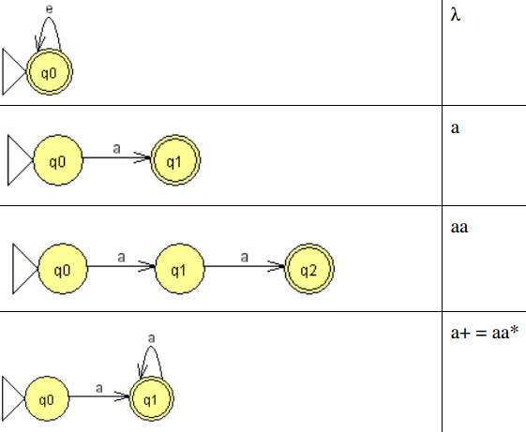
Examples of languages accepted by FA
FA
RE
Notes:
Lambda or twice Lambda or thrice Lambda or ……. All are equal to Lambda

Slide 43
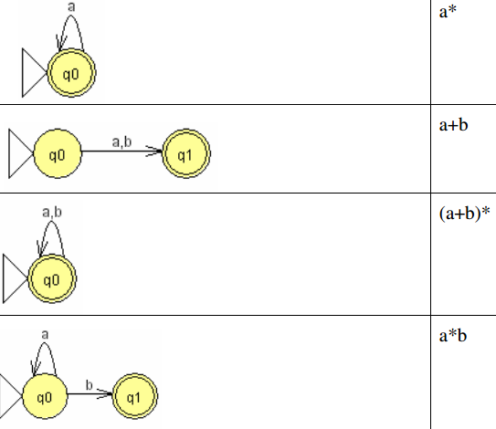
Examples of languages accepted by FA
FA
RE

Slide 44
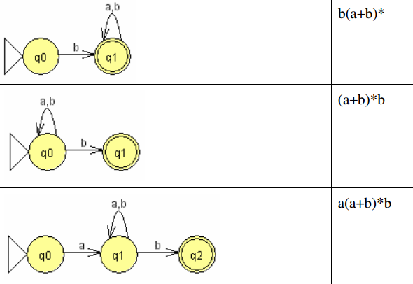
Examples of languages accepted by FA
FA
RE

Slide 45
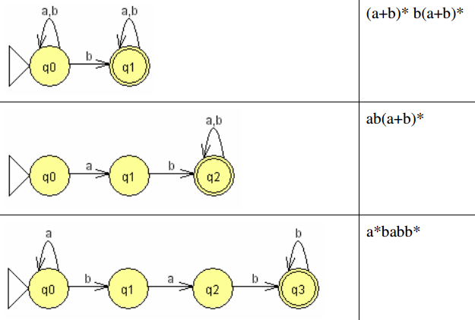
Examples of languages accepted by FA
FA
RE

Slide 46
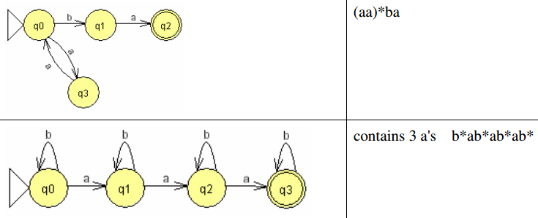
Examples of languages accepted by FA
FA
RE

Slide 47
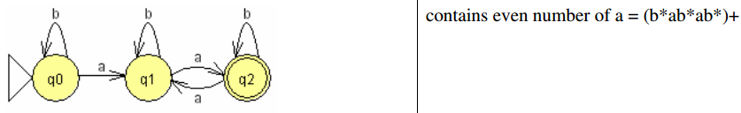
Examples of languages accepted by FA
FA
RE

Slide 48
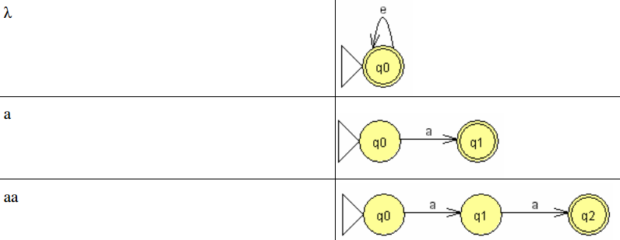
Converting Regular Expression into a Finite Automata
RE
FA

Slide 49
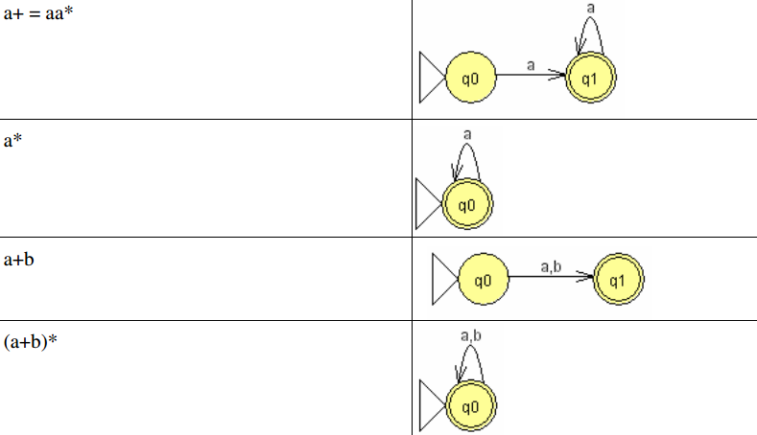
Converting Regular Expression into a Finite Automata
RE
FA
Notes:
First diagram is NFA

Slide 50
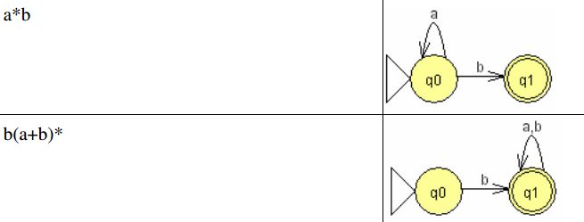
Converting Regular Expression into a Finite Automata
RE
FA
Notes:
Second is NFA

Slide 51
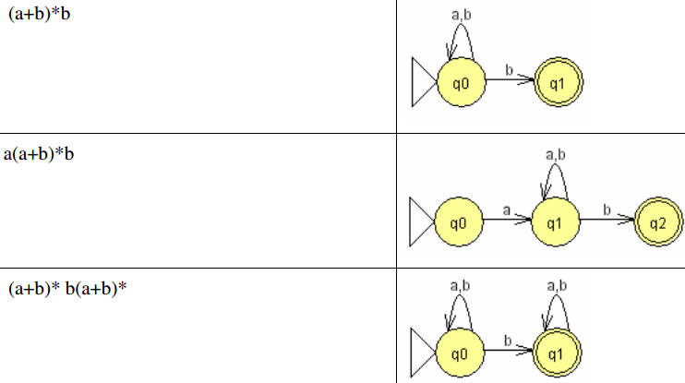
Converting Regular Expression into a Finite Automata
RE
FA
Notes:
ALL these diagrams are NFA

Slide 52
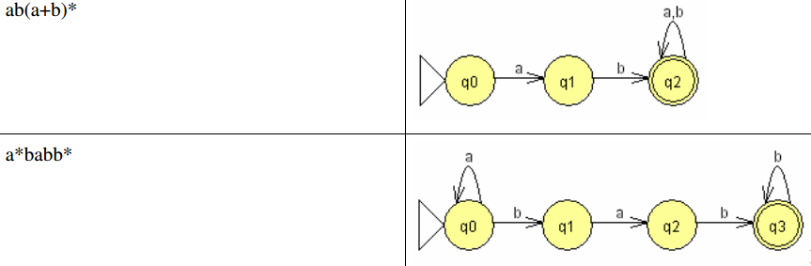
Converting Regular Expression into a Finite Automata
RE
FA
Notes:
ALL these diagrams are NFA

Slide 53
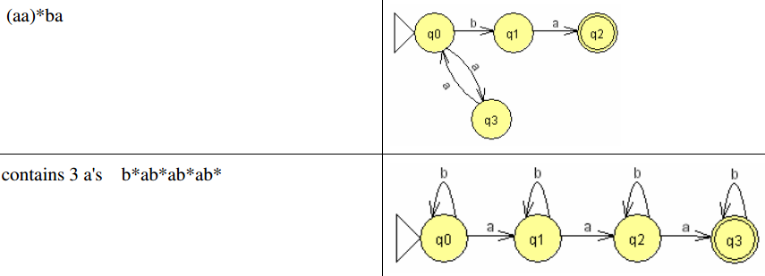
Converting Regular Expression into a Finite Automata
RE
FA

Slide 54
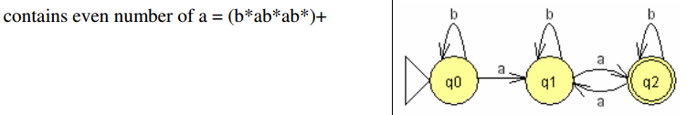
Converting Regular Expression into a Finite Automata
RE
FA

Slide 55
Automaton
temporary memory
Automaton
input memory
CPU
output memory
Program memory

Slide 56
Finite Automaton
Input
String
Output
Finite
Automaton
String

Slide 57
Different Kinds of Automata
Automata are distinguished by the temporary memory:
Finite Automata: no temporary memory
Pushdown Automata: stack
Turing Machines: random access memory

Slide 58
Power of Automata
Finite
Automata
Pushdown
Automata
Turing
Machine

Slide 59
Non Deterministic Finite Automata NFA
In a nondeterministic machine, several choices may exist for the next state at any point.
NFA = “a 5-tuple “ ➔(Q, Σ, δ, q₀, F)
Q A finite set of states
Σ A finite input alphabet union {Λ}
q₀ The initial/starting state, q₀ is in Q
F A set of final/accepting states, which is a subset of Q
δ A transition function
Takes a state and input symbol as arguments.
Returns a set of states instead a single state as in DFA.

Slide 60
Non Determinism/ Determinism (Cont.)
The difference between a deterministic finite automaton (DFA) and a nondeterministic finite automaton (NFA):
1. Every state of a DFA always has exactly one exiting transition arrow for each symbol in the alphabet.
2. in a DFA, labels on the transition arrows are symbols from the alphabet. While NFA can have an arrow with the label є.
3. Nondeterminism may be viewed as a kind of parallel computation.

Slide 61
Non Determinism/ Determinism (cont.)
If a state with an є symbol on an exiting arrow is encountered, then without reading any input, the machine splits into multiple copies, one following each of the exiting є -labeled arrows and one staying at the current state.

Slide 62
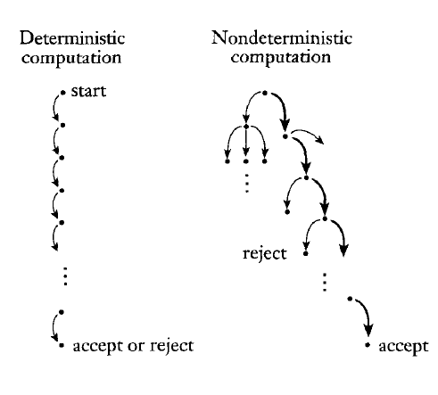

Slide 63
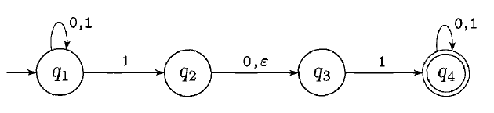
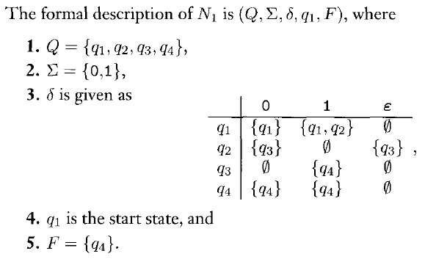
Nondeterministic Finite Automaton Example

